Slide 2
Learning Objectives (1 of 2)
Describe the systems development life cycle (SDLC) as a method for developing information systems
Explain the tasks involved in the planning phase
Explain the tasks involved in the requirements-gathering and analysis phase
Explain the tasks involved in the design phase

Slide 3
Learning Objectives (2 of 2)
Explain the tasks involved in the implementation phase
Explain the tasks involved in the maintenance phase
Describe new trends in systems analysis and design, including service-oriented architecture, rapid application development, extreme programming, and agile methodology

Slide 4
Systems Development Life Cycle: An Overview
Systems development life cycle (SDLC): series of well-defined phases performed in sequence
Serves as a framework for developing a system or project
Each phase’s output becomes the input for the next phase
Suitable for an information system that needs to be designed from scratch

Slide 5
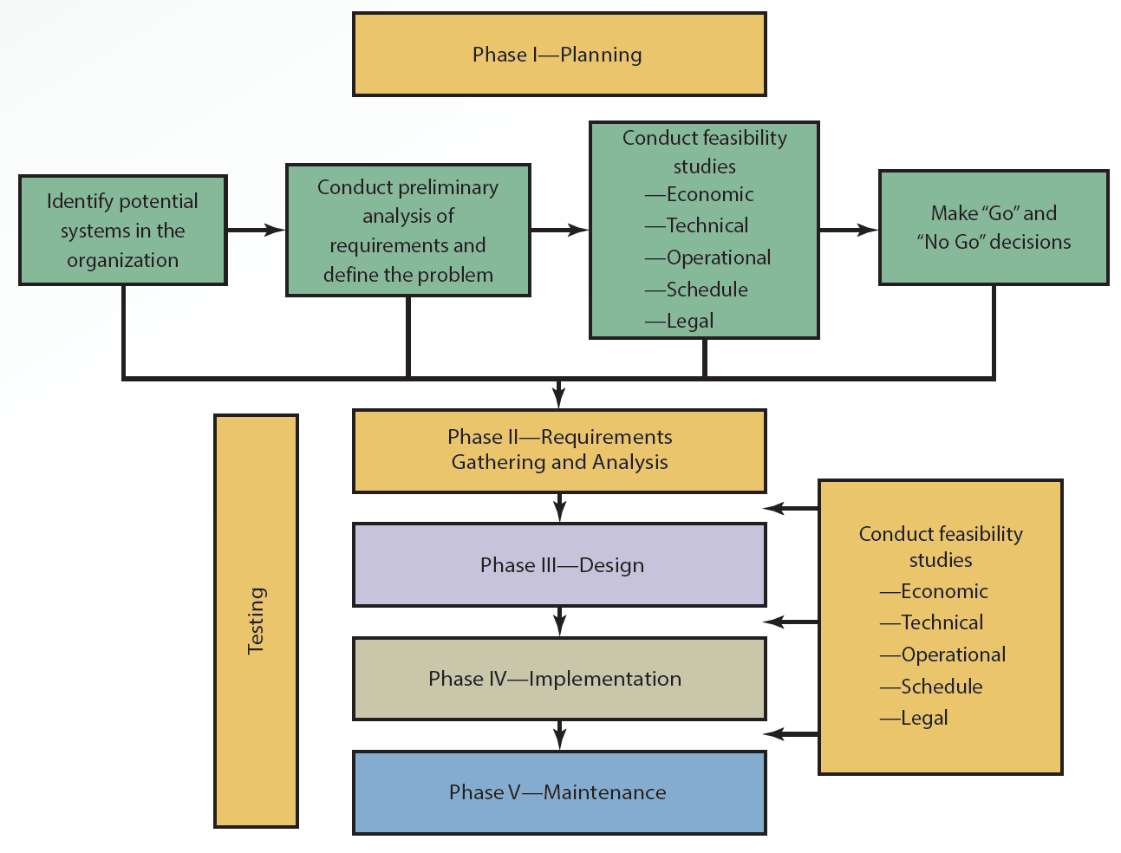
10.1 Phases of the SDLC

Slide 6
Phase 1: Planning (1 of 2)
Systems designer must define the problem the organization faces
Problem can be identified internally and externally
Analysts assess needs of the organization or a specific group of users
Organization’s strategic goals
How proposed system can support goals
Factors critical to the system’s success
Criteria for evaluating performance

Slide 7
Phase 1: Planning (2 of 2)
Analysts must get feedback from users on the problem
At the end of the phase, users and top management should have a clear view of the why, who, when, and what of the problem

Slide 8
Formation of the Task Force (1 of 3)
Should consist of representatives from:
Different departments
Systems analysts
Technical advisors
Top management
Involves collecting user feedback and working toward getting users involved from the beginning

Slide 9
Formation of the Task Force (2 of 3)
Internal users: employees who use the system regularly
Offer feedback on the system’s strengths and weaknesses
External users: not employees but do use the system
Customers, contractors, suppliers, and other business partners
Not part of the task force but their input is essential

Slide 10
Formation of the Task Force (3 of 3)
Joint application design (JAD)
Collective activity involving users, top management, and IT professionals
Centered on a structured workshop where users and system professionals unite to develop an application
Helps ensure that collected requirements are not narrow and one-dimensional in focus

Slide 11
Feasibility Study
Measure of how beneficial or practical an information system will be to an organization
Analysts investigate a proposed solution’s feasibility
Determine how best to present the solution to management
Dimensions: economic, technical, operational, scheduling, and legal

Slide 12
Economic Feasibility (1 of 2)
Assesses a system’s costs and benefits
Tangible development and operating costs for the system have to be itemized
Leads to the creation of a budget
Tangible and intangible benefits have to be identified and measured
Challenge: accurately assessing intangible costs and benefits

Slide 13
Economic Feasibility (2 of 2)
Cost-effectiveness analysis has to be conducted
Methods: payback, net present value (NPV), return on investment (ROI), and internal rate of return (IRR)
Cost-benefit analysis (CBA) report
Used to sell the system to top management

Slide 14
Technical Feasibility
Assessing whether the technology to support the new system is available or feasible to implement
Organizations that lack the expertise, time, or personnel to implement the new system might lack technical feasibility
Steps should be taken to address shortcomings and consider the new system

Slide 15
Operational Feasibility
Measure of how well the proposed solution will work in the organization and how internal and external customers will react to it
Requires assessing the worth of implementing the information system

Slide 16
Scheduling Feasibility
Concerned with whether the new system can be completed on time
Failure to deliver in time leads to loss of customers
Problem can be minimized by using project management tools

Slide 17
Legal Feasibility
Concerned with legal issues
Addresses questions such as:
Will the system violate any legal issues in the country where it will be used?
Are there any political repercussions?
Is there any conflict between the proposed system and legal requirements?

Slide 18
Phase 2: Requirements-Gathering and Analysis (1 of 2)
Analysts define the problem and generate alternatives for solving it
Team attempts to understand the requirements for the system
Analyzes requirements to determine the main problem with the current system or processes
Looks for ways to solve problems by designing the new system

Slide 19
Phase 2: Requirements-Gathering and Analysis (2 of 2)
Analysis and design approaches
Structured systems analysis and design (SSAD)
Sequential approach that treats process and data independently
Object-oriented
Combines process and data analysis
Models created during the analysis phase constitute design specifications

Slide 20
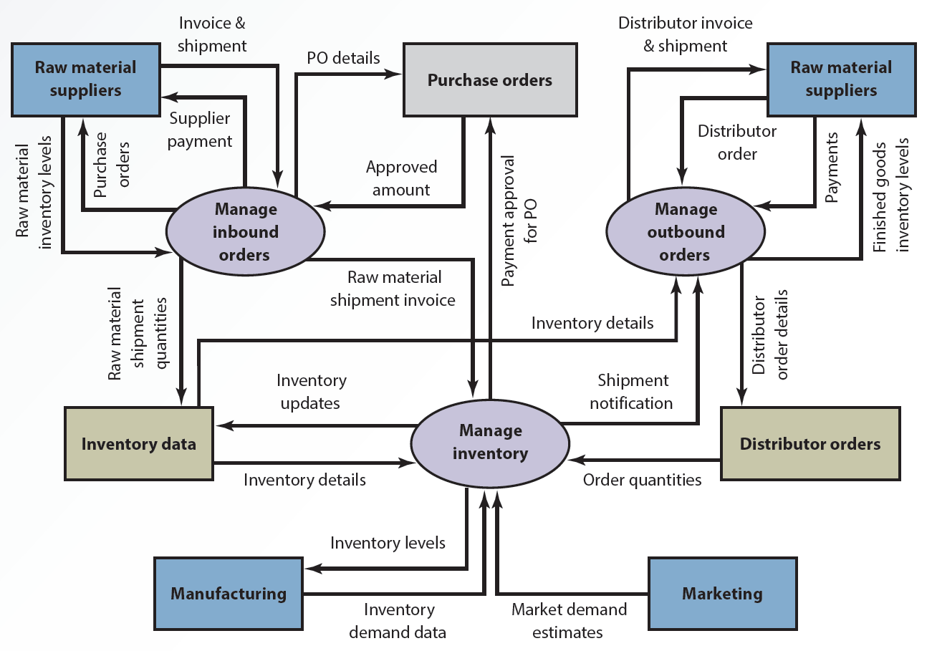
10.2 Data Flow Diagram for ABC’s Inventory Management System

Slide 21
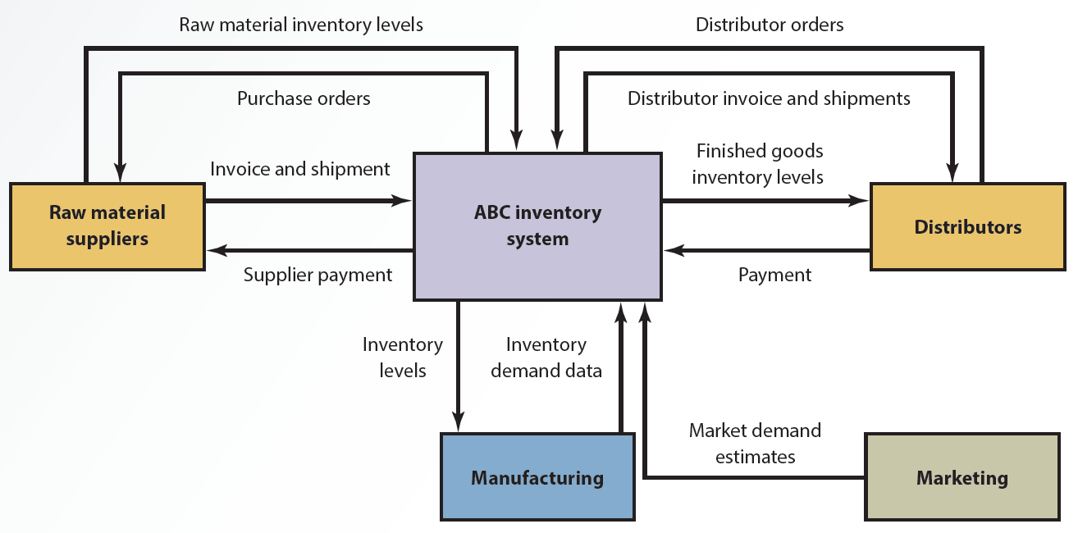
10.3 Context Diagram for ABC’s Inventory Management System

Slide 22
Phase 3: Design (1 of 3)
The most realistic solution that offers the highest payoff for the organization is chosen
Details of the proposed solution are outlined

Slide 23
Phase 3: Design (2 of 3)
Document with exact specifications for implementing the system is drafted
Files and databases
Forms and reports
Documentation and procedures
Hardware and software
Networking components
General system specifications

Slide 24
Phase 3: Design (3 of 3)
Consists of three parts
Conceptual design: overview of the system and does not include hardware or software choices
Logical design: makes conceptual design specific by indicating hardware and software
Physical design: created for specific platforms

Slide 25
Computer-Aided Systems Engineering (1 of 3)
Computer-Aided Systems Engineering (CASE) tools automate parts of the application development process
Helpful for investigation and analysis in large-scale projects

Slide 26
Computer-Aided Systems Engineering (2 of 3)
Help analysts:
Keep models consistent with each other
Document models with explanations and annotations
Ensure that models are created according to specific rules
Create a single repository of all models related to a single system
Track and manage design changes
Create multiple versions of the design

Slide 27
Computer-Aided Systems Engineering (3 of 3)
CASE tools are similar to computer-aided design (CAD) tools
Capabilities vary; depend on the product
Create output in the form of:
Specifications documents
Documentation of the analysis
Design specifications
Logical and physical design documents
Code modules

Slide 28
Prototyping (1 of 2)
Small-scale version of the system is developed
Illustrates system benefits and allows users to offer feedback
Purposes
Establishes system requirements
Determines a system’s technical feasibility
Sells the proposed system to users and management using a selling prototype

Slide 29
Prototyping (2 of 2)
Steps in prototyping
Define initial requirements
Develop the prototype
Review and evaluate the prototype
Revise the prototype

Slide 30
Prototyping Development Tools
Development tools used in prototyping
Spreadsheet and database management packages
Visual Basic
CASE tools and third- and fourth-generation programming languages
User interface design tools

Slide 31
Advantages and Disadvantages of Prototyping (1 of 2)
Advantages
Method for investigating an environment
Reduces the need to train information system users and costs
Increases the system’s chance of success by encouraging users’ involvement
Allows easy modification
Improves documentation and communication

Slide 32
Advantages and Disadvantages of Prototyping (2 of 2)
Disadvantages
Requires excessive support and assistance from users and top management
May not reflect the final system’s actual operation
Misleading; working prototype convinces the team that the final system will work

Slide 33
Phase 4: Implementation (1 of 3)
Team configures the system and procures components for it
Tasks involved
Acquiring new equipment
Hiring and training new employees
Planning and designing physical layout
Coding and testing
Designing security measures and safeguards
Creating a disaster recovery plan

Slide 34
Phase 4: Implementation (2 of 3)
Conversion options
Parallel: old and new systems run simultaneously for a short time to ensure the new system works correctly
Phased-in-phased-out: as each module of the new system is converted, the corresponding part of the old system is retired
Process continues until the entire system is operational

Slide 35
Phase 4: Implementation (3 of 3)
Plunge (direct cutover): old system is stopped and the new system is implemented
Pilot: analyst introduces the system in a limited area of the organization
Implemented in the rest of the organization in stages or all at once if the system works correctly

Slide 36
IT Project Management (1 of 2)
Activities to plan, manage, and control information system creation and delivery
Tools and techniques
Help solve scheduling problems, plan and set goals, and highlight potential bottlenecks
Project management software helps study cost, time, and impact of schedule changes
PERT (program evaluation review technique)
CPM (critical path method)

Slide 37
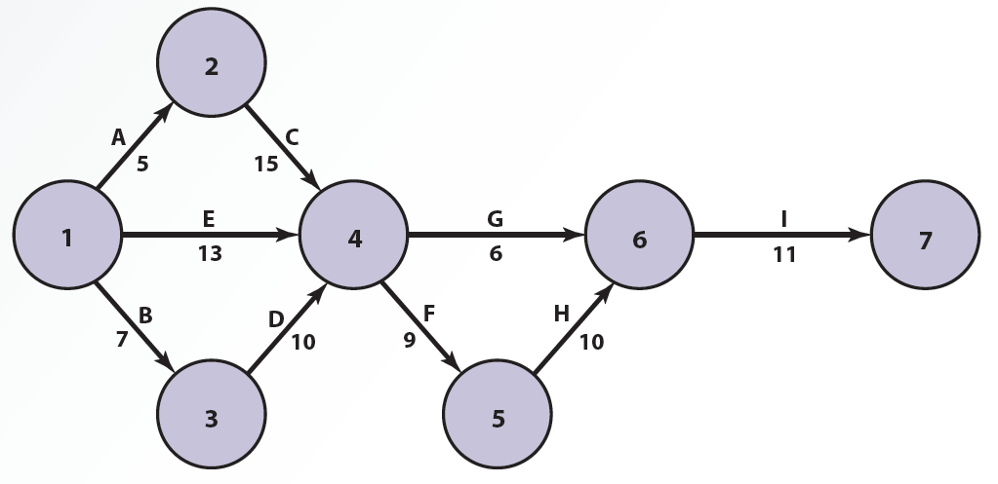
10.4 PERT Network

Slide 38
IT Project Management (2 of 2)
Gantt chart
Constructed using the critical path
Allows the systems analyst to monitor the progress of the project
Helps detect delay in the daily operation of the project

Slide 39
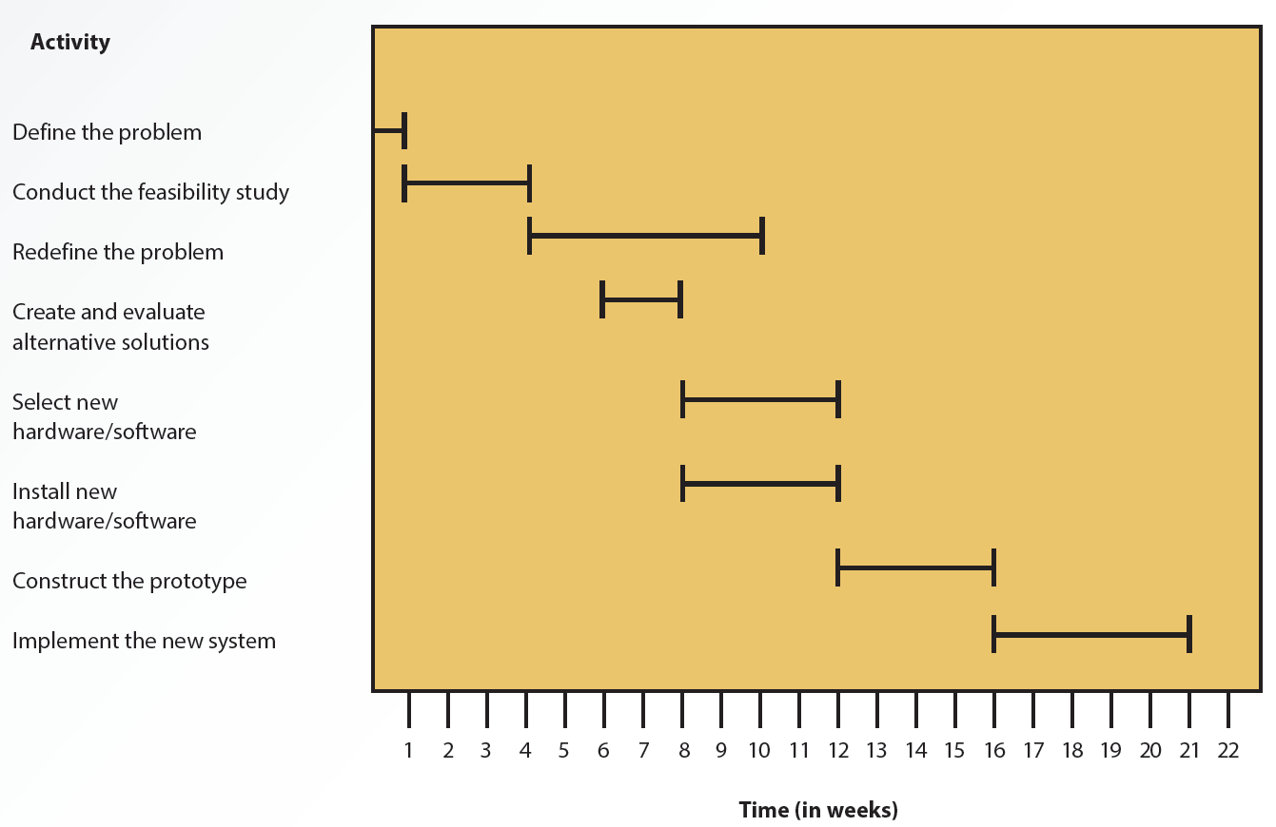
10.5 Gantt Chart

Slide 40
Request for Proposal (1 of 3)
Written document with detailed specifications
Used to request bids for equipment, supplies, or services from vendors
Contains information on functional, technical, and business requirements of the proposed information system

Slide 41
Request for Proposal (2 of 3)
Advantages
All vendors get the same information and requirements, which aid in fair evaluation of bids
Useful to narrow down the list of prospective vendors
Disadvantage
Time consuming

Slide 42
Request for Proposal (3 of 3)
Request for information (RFI)
Alternative to an RFP
Screening document for gathering vendor information and narrowing the list of potential vendors
Helps manage selection of vendors by focusing on the project requirements crucial to selecting vendors

Slide 43
Implementation Alternatives
The SDLC approach is sometimes called insourcing
Organization’s team develops the system internally

Slide 44
Self-Sourcing (1 of 3)
End users develop information systems with less or no formal assistance from the information systems (IS) team
Use off-the-shelf software to produce custom-built applications
Helps reduce the backlog in producing information systems
Improves flexibility in responding to users’ information needs

Slide 45
Self-Sourcing (2 of 3)
Disadvantages
Possible misuse of computing resources
Lack of access to crucial data
Lack of documentation
Inadequate security for the applications and systems
Applications may not be up to IS standards
Lack of support from top management
Lack of training for prospective users

Slide 46
Self-Sourcing (3 of 3)
Organizations should develop guidelines for end users
Criteria for evaluating, approving or rejecting, and prioritizing projects
Data administration should be enforced
Ensures integrity and reliability of information

Slide 47
Outsourcing (1 of 2)
Organizations hire external vendors or consultants who specializes in providing development services
Crowdsourcing: process traditionally performed by employees or contractors to a crowd through an open call
Outsourcing types
Onshore
Nearshore
Offshore

Slide 48
Outsourcing (2 of 2)
Advantages
Less expensive
Quick delivery
Helps organizations concentrate on core functions and other projects
Disadvantages
Loss of control
Dependency
Vulnerability of strategic information

Slide 49
Phase 5: Maintenance (1 of 2)
Information system is operating
Enhancements and modifications to the system have been developed and tested
Hardware and software components have been added or replaced

Slide 50
Phase 5: Maintenance (2 of 2)
Performance data and information is gathered and assessed
Feedback from users, customers, and other people affected by the new system is collected
Corrective action is taken if the system’s objectives are not being met

Slide 51
New Trends in Systems Analysis and Design
SDLC model may be inappropriate if:
There is a lack of specifications
Input-output process cannot be identified completely
Problem is “ad hoc”
Users’ needs change constantly

Slide 52
Service-Oriented Architecture (1 of 2)
Focuses on development, use, and reuse of small, self-contained blocks of codes
Attempts to solve software development issues by recognizing, accepting, and leveraging existing services

Slide 53
Service-Oriented Architecture (2 of 2)
Blocks of codes are reused in different applications
Allow new business processes to be created from a pool of existing services
Benefits
Reduced application development time
Greater flexibility
Improved return on investment

Slide 54
Rapid Application Development
Concentrates on user involvement and continuous interaction between users and designers
Combines the planning and analysis phases to develop a prototype of the system
Uses an iterative process
Design, development, and testing steps are repeated as needed based on feedback
Problems: narrow focus and low quality

Slide 55
Extreme Programming (1 of 2)
Method for developing software applications and IS projects
Project is divided into smaller functions
Developers cannot move to the next phase until the current phase is finished
Each function is developed step-by-step
Advantages
Delivers the system to users as early as possible
Makes changes that the user suggests

Slide 56
Extreme Programming (2 of 2)
Pair programming
Two programmers participate in one development effort at one workstation
Each programmer performs the action that the other is not currently doing
Helps in quick detection and correction of programming mistakes

Slide 57
Agile Methodology (1 of 2)
Focuses on an incremental development process and timely delivery of working software
Less emphasis on team coding and more emphasis on limiting the project’s scope
Sets a minimum number of requirements and turns them into a working product

Slide 58
Agile Methodology (2 of 2)
Goals of the step-by-step approach
Respond to changing needs
Develop working, high-quality software
Strives to deliver software quickly
Better meet customer needs

Slide 59
Summary (1 of 2)
Systems development life cycle (SDLC) is a series of well-defined phases performed in sequence
Planning phase: forming a task force and conducting a feasibility study
Requirements-gathering and analysis phase: analysts define the problem and generate alternatives for solving it

Slide 60
Summary (2 of 2)
Design phase: analysts choose a realistic solution that offers the highest payoff for the organization
Solution is transferred from paper to action in the implementing phase
Maintenance phase: enhancements and modifications to the system are developed and tested

